Slide 1
Weekly report: Machine Bed & Yaw System
Week No - 5
Date: 28.10.2025
Supervisor: Prof. Peter Quell
Shoukat Abbas, Luksh Chawla, Sathishkumar Venkatachalam, Shrihari G Kadam
Presented by – Shrihari G Kadam

Slide 2
Contents
Yaw Bearing comparison
Yaw Drive specifications
Hand-made concept sketches
Yaw system Calculations
Yaw system Calculations – Bearing selection
References
Shrihari G Kadam

Slide 3
Yaw Bearing
1. Optimus Shakti 5.0 (Final Report – Machine Bed, Yaw System 2025)
Yaw bearing used: Double-row four-point contact ball bearing from ThyssenKrupp (upscaled to 4000 mm outer diameter).
Reasons:
High tilting-moment capacity (≈29 MN·m)
Compact design
Ability to handle combined axial forces
Smooth rotation & long service
Shrihari G Kadam

Slide 4
Yaw Bearing
2. Optimus 92 LE (Report_Optimus92LE_Machinebed_Yawsystem Rev1 2019)
Yaw bearing used: ThyssenKrupp yaw bearing (design referenced and 90 % verified under DNV GL guidelines).
Reasons:
Certified company
Industry-standard bearing
Transferring high loads from nacelle to tower
Validated by manufacturer data
Ensuring compliance
Shrihari G Kadam

Slide 5
Yaw Bearing Comparison
 | Parameter | Optimus Shakti 5.0 (2025) | Optimus 92 LE (2019)
1 | Bearing Type | Double-row four-point contact ball bearing | Four-point contact ball bearing
2 | Manufacturer | ThyssenKrupp (Series 09, upscaled) | ThyssenKrupp (Series 09, standard)
3 | Outer Diameter (approx.) | 4000 mm (upscaled from 3128 mm) | ~3100 mm
4 | Gear Type | External gearing | External gearing
5 | Main Function | Enables yaw rotation under heavy load | Transmits yaw and structural loads
6 | Load Capacity | Tilting moment capacity (29,000 kNm (design limit 25,000 kNm) | Designed per manufacturers load curves for 2 MW turbine loads
[ 1 ]
Shrihari G Kadam

Slide 6
Yaw Bearing Comparison
 | Parameter | Optimus Shakti 5.0 (2025) | Optimus 92 LE (2019)
7 | Design Basis | Upscaled using section modulus method to meet higher 5 MW turbine loads | Used directly from ThyssenKrupp catalogue (suitable for 2 MW)
8 | Standards Followed | IEC 61400, DNVGL-ST-0361 | IEC 61400-1, DNVGL-ST-0361, NREL DG03
9 | Reason for Selection | High load-bearing capacity, compact design, supports combined loads efficiently | Proven reliability, certified industrial design, sufficient for lower power turbine
10 | Turbine Rating | 5 MW | 2 MW
11 | Yaw Bearing Verification | Analytical upscaling & structural validation | 90% verified under DNV GL guidelines
Shrihari G Kadam

Slide 7
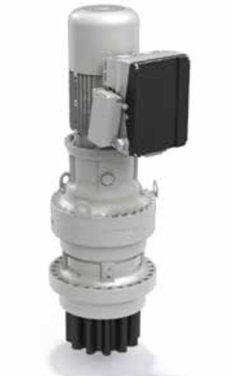
Yaw Drive Specifications-Optimus Shakti
The Optimus Shakti wind turbines utilized 716T4 Bonfiglioli Drives. A key design feature was the use of 7 yaw drives per turbine. Specifications
Motor: BE160 motor (11-15kW), controlled by a DGM Inverter.
Gear Type: Planetary gear system for high torque and load capacity.
Torque: Capable of delivering rated torque up to 150,000 Nm and peak torque up to 400,000 Nm.
Benefit of 7 Drives: Distributes the load and ensures highly accurate directional control.[2]
Source: Bonfiglioli 716 T4F + BE160 + DGM Inverter
Shrihari G Kadam

Slide 8
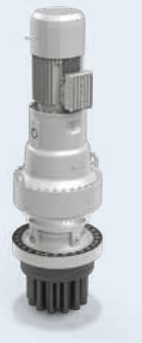
Yaw Drive System Suggestion- Optimus Syria Project
714 T4F Bonfiglioli Specifications
Gear System: Rugged planetary gear system for high durability and excellent load capacity
Torque Capacity: High turning force, with the 714TW model delivering a rated torque of around 150,000 Nm.
Benefit of 6 Drives: Distributes the operational stress, ensuring reliable performance and extending the service life of the system.
Purpose: Rotate the nacelle and keep the blades aligned with the wind for maximum efficiency.
Source: Bonfiglioli 714 T4F + BN132 Series
Shrihari G Kadam

Slide 9
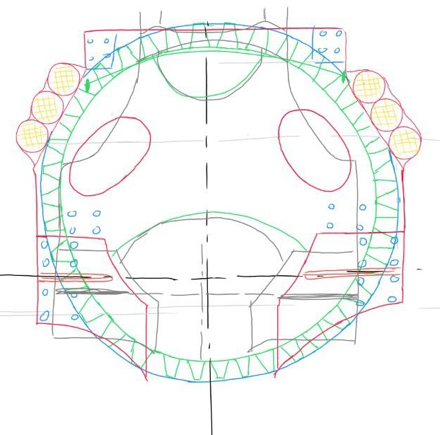
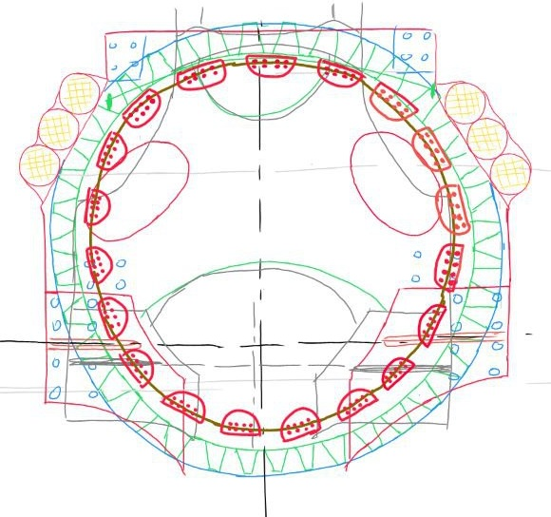
Hand-made Concept Sketches
Top view of the Casted machine Bed
Casted machine Bed with Brake Calipers
Shrihari G Kadam

Slide 10
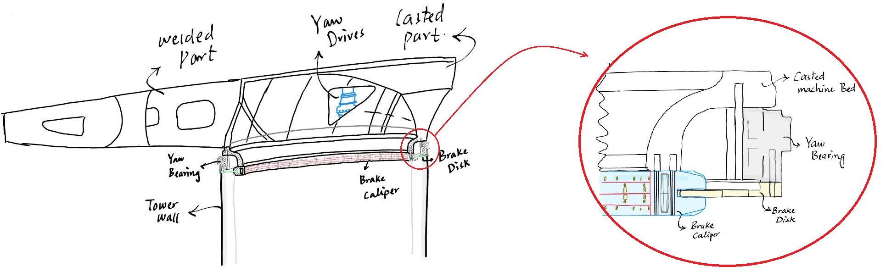
Hand-made Concept Sketches
Cross-section of the machine bed along with the Yaw system, yaw bearing, brake disk, and brake calipers
Shrihari G Kadam

Slide 11
Yaw System Calculation – Based on 714 T4F Drive
Based on load estimations by Christian Bulling:
• Maximum yaw moment (MmaxMz) = 23,000 kNm
• Operational yaw moment (Mz) = 8,300 kNm
• Maximum tilting moment (Myz) = 25,000 kNm
• Radial load (Fyz) = 2,000 kN
• Axial load (Fx) = 700 kN
Shrihari G Kadam

Slide 12
Yaw System Calculation – Based on 714 T4F Drive
Input Parameters
• Drive torque (Mdrive) = 150 kNm
• Pinion pitch circle diameter (PCDpinion) = 288 mm
• Bearing pitch circle diameter (PCDbearing) = 4008 mm
• External gear ratio (iex) = PCDbearing / PCDpinion = 13.9167
• Braking torque per caliper (Mcaliper) ≈ 726 kNm
Shrihari G Kadam

Slide 13
Yaw System Calculation – Based on 714 T4F Drive
Number of Yaw Drives for Operational Yaw Moment
Each drive torque at bearing = Mdrive × iex = 150 × 13.9167 = 2087.5 kNm
N = M_op / (M_drive × i_ex) = 8300 / 2087.5 = 3.98 ≈ 4 drives (theoretical minimum).
In practice, 6 or 7 drives are used for redundancy and better load sharing.
Motor Brake Yaw Moment
Total motor brake yaw moment (M_motor_yaw) = n × (M_drive × i_ex)
• For 4 drives: 4 × 2087.5 = 8,350 kNm
• For 6 drives: 6 × 2087.5 = 12,525 kNm
• For 7 drives: 7 × 2087.5 = 14,612.5 kNm
Shrihari G Kadam

Slide 14
Yaw System Calculation – Bearing Selection Note
Hydraulic Brake Torque Requirement
M_hydraulic = M_max - M_motor_yaw
• 4 drives: 23,000 - 8,350 = 14,650 kNm
• 6 drives: 23,000 - 12,525 = 10,475 kNm
• 7 drives: 23,000 - 14,612.5 = 8,387.5 kNm
The upscaled ThyssenKrupp double-row four-point bearing can tolerate a tilting moment of 29,000 kNm, which exceeds the required 25,000 kNm.
Hence, it is suitable for use
Shrihari G Kadam

Slide 15
References
[1]. Bonfiglioli (accessed 19 Oct 2025). Solutions for Wind. https://www.bonfiglioli.com/_default_upload_bucket/TR_CAT_WIND_STD_ENG_R05_0.pdf
Shrihari G Kadam

